Slide 1
Graduate School of Engineering and Natural Sciences
Graduate Programs Orientation

Slide 2

Graduate School of Engineering and Natural Sciences
Healthcare Systems Engineering
PhD
MS (With Thesis)
Climate Change, Energy and Health
(30% English)
MS (With Thesis)
PhD
MS (With Thesis)
MS (Without Thesis)
Electrical-Electronics and Cyber Systems Engineering
PhD
MS (With Thesis)
MS (Without Thesis)
Biomedical Engineering and Bioinformatics
İnşaat Yönetimi ve Hukuku
MS (Without Thesis)
Yapılı Çevre ve Sağlık
PhD
MS (With Thesis)
MS (Without Thesis)
Civil Engineering
(30% English)
PhD
MS (With Thesis)
Computer Engineering
PhD
MS (With Thesis)
sens.medipol.edu.tr

Slide 3
Management Organization
Prof. Dr. Yasemin YUKSEL DURMAZ, Director of GSENS
Tuba ÖZCAN Secretary of GSENS
Secretariat of GSENS

Slide 4
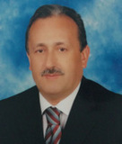
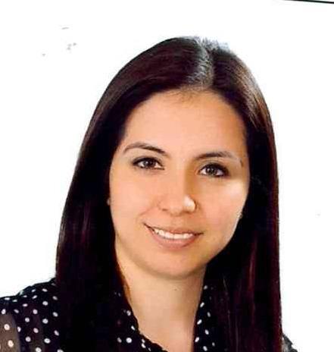
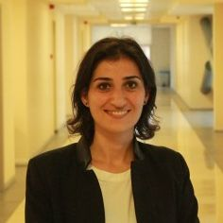
Problem Solving Organization
Secretariat of GSENS
Tuba ÖZCAN Secretary of GSENS
Prof. Dr. Yasemin YUKSEL DURMAZ, Director of GSENS
Advisor

Slide 5
First visit “sens.medipol.edu.tr”
Courses
Guideline for graduate student
Guideline and template for thesis
Procedures that needs to be done after defense exam
Forms
Letters
Application details
Program details
Course schedule
https://www.medipol.edu.tr/en/academics/graduate-schools/graduate-school-of-engineering-and-natural-sciences

Slide 6
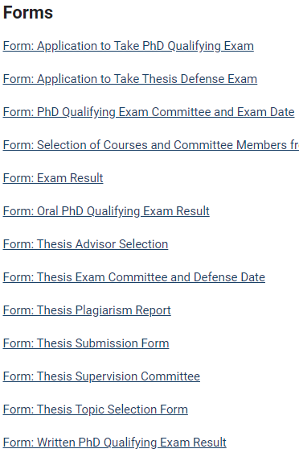
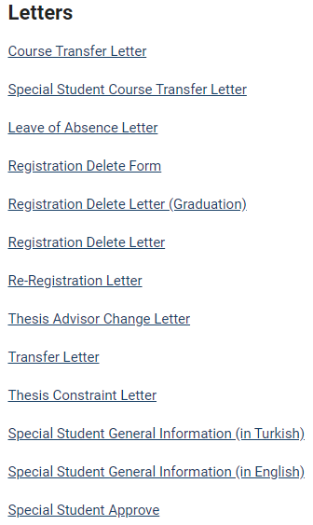
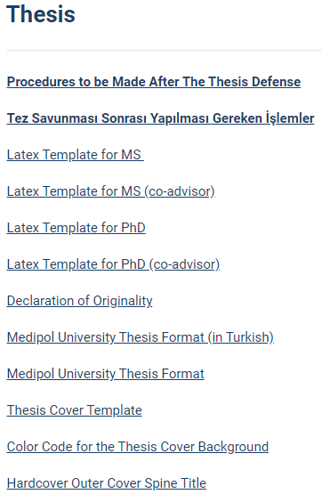
http://sens.medipol.edu.tr/forms/
http://sens.medipol.edu.tr/thesis/

Slide 7
Getting into GSENS
ONLINE Application
Master Application
Diploma (GPA)
ALES for MS (65 for National)
YOKDIL(60)-TOEFL(72)-PE (60/100)
Interview
Evaluation for National
GPA (%20)
ALES (%50)
Interview (30)
Evaluation for International
GPA (%50)
Interview (%50)
PhD Application
Diploma (GPA)
ALES (75 for National)
TOEFL(72) (compulsory)
PhD Application without MS
Diploma (GPA min 3.00/4.00 or top three in the class)
ALES (80 for national)
YDS-YOKDIL(60)-TOEFL(72) (compulsory)
Final Registration with original copy of the documents

Slide 8
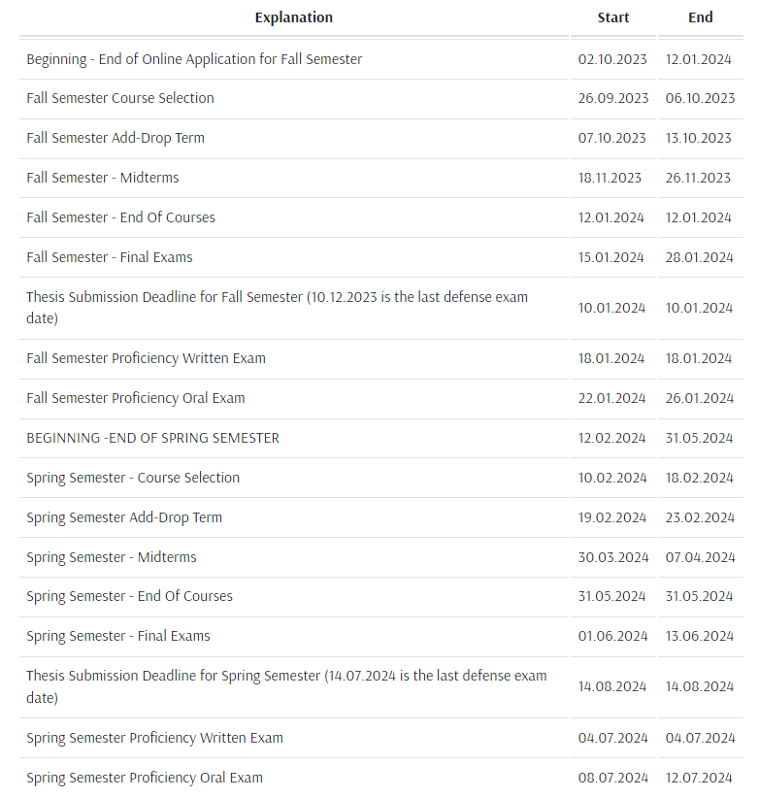
Academic Calendar

Slide 9

Each Semester
Course selection with approval of your advisor.
BAP application.
Completion of BAP document based on % fellowship.
  All first semester students are fully supported as long as they are full time researcher in the university, but they still need to apply for BAP and deliver proper document to accounting department.
How does BAP work?
GPA
Attendance
Research Performance
Grading by advisor

Slide 10
MS ECTS
Minimum Course Requirement | Graduate Seminar Scientific Research Techniques and Ethics 7 technical courses (21 credits) | Have to be 60 ECTS (except for Scientific Research Techniques and Ethics)
Minimum ECTS Requirement | 120 | (7+2) courses 60 ECTS +Thesis 60 ECTS
PhD | With MS Degree | ECTS | Without MS Degree | ECTS
Minimum Course Requirement | Graduate Seminar Scientific Research Techniques and Ethics* 7 technical course (21 credits) | 60 | Graduate Seminar Scientific Research Techniques and Ethics 14 technical courses (42 credits) | 120
 | Qualifier | 30 | Qualifier | 30
 | Thesis | 120 | Thesis | 120
 | Guided Research | 30 | Guided Research | 30
Minimum ECTS Requirement | 240 |  | 300
Course load must be completed within 4 semesters, otherwise your studentship will be ended.
Missing ECTS can be completed with “Guided Research I and II”.
Students CAN transfer maximum half of the required course credits. This means max GSENS accepts your 3 courses
*If it hasn’t taken before
Scientific Research Techniques and Ethics course is not a technical course

Slide 11
Courses
List of the course can be found at sens.medipol.edu.tr
MS student can take max of 2 undergraduate courses if they haven’t taken before
However, PhD student can not take the undergraduate courses
MS and PhD student can take max of 2 courses from different graduate schools (PhD without MS can take max of 4 courses)
PhD students can take MS courses by considering the balance in the transcript
MS student can take both MS and PhD courses. However, their PhD courses that they took during their MS won`t be count as course load for PhD if they continue to PhD program

Slide 12
Program Durations
Master | PhD
 | With MS | Without MS
4 | 8 | 10
6 | 12 | 14
Min. Time (semester)
Max. Time (semester)
End of the maximum time, who could not complete the program requirement, their studentship will be terminated.
Maximum time to complete MS courses is 4 semester
Maximum time to complete PhD courses is 4 semester for PhD with MS and 6 semester PhD without MS.
Early graduation is possible from MS program (end of 3rd semester), however requires solid success.

Slide 13

Advisor
The advisor assigned in the first semester on Mebis system is your academic advisor and is the person who approves your course selections (for new student).
It is obligatory to assign a Thesis/Project advisor to each graduate student until the end of the first semester. For this reason, students are required to fill in the relevant forms at the end of the first semester and submit them to GSENS.
The thesis/project topic must be decided at the end of the second semester at the latest. For this reason, students are required to fill in the relevant forms at the end of the first semester and submit them to GSENS.
If the thesis work requires more than one advisor, a co-advisor from the university or out of university can also be selected.
The student's requests for a reasoned change of advisor are submitted to GSENS and become final with the decision of the Graduate School Administrative Board.
GSENS needs to be informed in advance for advisor change or co-advisor assignment requests. Last min request are not considered.
In the thesis topic changes, the remaining time for the completion of the thesis should be considered and the justification should be presented according to the legislation. Thesis Title changes that do not cause any change in the thesis should be submitted to GSENS with a petition.
sens.medipol.edu.tr/forms/

Slide 14
Finalizing Thesis and Graduation (MS)
Start planning your defense with your advisor 2 months prior to your expected graduation (defense) day. Be careful about thesis submission deadlines.
Obtained results should be written as a thesis by following the rule the GSENS defined.
Completed thesis should be submitted to advisor for his/her review. Please provide your advisor time for review like minimum 2 weeks before thesis submission.
Advisor approves and submits thesis to GSENS along with all required information for thesis defense like committee members, defense date and time etc…
Forms need to be filled;
  Thesis submission form.
  Application to take thesis defense exam.
  Thesis exam committee and defense date form .
  Thesis plagiarism report form.
GSENS creates the originality report and sends it along with thesis to advisor and other committee members. Theses with an originality rate of less than 15% are accepted. The thesis originality report should not be sent to the members of the jury before it is considered successful. This takes 3-4 weeks.
  Once it is delivered to your thesis committee you have a month to defend it.
sens.medipol.edu.tr/forms/

Slide 15
Defense Exam (MS)
Defense committee;
  3 committee members including student’s advisor.
  1 committee member should be from another university
  Co-advisor can join the exam.
Exam results should be reported to GSENS within 3 days.
  Forms need to be filled.
    Exam result form.
sens.medipol.edu.tr/forms/

Slide 16
Defense Exam (MS)
Follow the procedure for diploma
✓
Accepted
There are 3 possible results:
Your studentship will be terminated.
Rejected
✗
Correction
Max. 3 months for correction
Re-defense

Slide 17
Diploma (MS)
The thesis, which has been corrected within a month and prepared according to the thesis writing guideline, needs to be checked by the relevant GSENS Thesis Control Supervisor and the Thesis Checklist needs to be completed. Before this process, the STUDENT'S ADVISOR MUST REVIEW THE THESIS ONE LAST TIME.
The thesis, which has been prepared and checked according to the thesis writing guideline (2 hard copies containing the signatures of all jury members and the result page of the originality report, and 1 electronic copy as CD) should be submitted to GSENS.
Graduation date will be the defense date.
If necessary, student can request 1 more month to complete this process.
  However, after this point, if thesis won't be submitted, student will be passive student and won't be able to use any right of being student. (Immigration office and army for native students)
  End of the max. time for master program, studentship will be terminated.

Slide 18

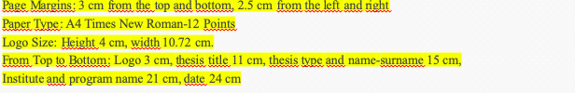
CMYK: 100, 81, 0, 51

Slide 20
PhD
Course load should be completed within 4 semester.
Latest 5th semester PhD students need to take Qualifying exam (without MS-> 7th semester).
In the 4th semester they can register to QE preparation course along with the course.
Qualifying Exam (QE)
Two times in a year (January and July)
Register to QE preparation course.
End of that semester submit the form.
  Application to take PhD Qualifying Exam
sens.medipol.edu.tr/forms/

Slide 21
2023-2024 Academic Year Qualifying Exam Calendar
Fall Semester Written Qualifying Exam | 18.01.2024
Fall Semester Oral Qualifying Exam | 22.01.2024
Spring Semester Written Qualifying Exam | 04.07.2024
Oral Semester Oral Qualifying Exam | 08.07.2024

Slide 22
QE
Sub-committee contains student`s advisor
Each PhD program sets their QE committee which forms sub committee based on student`s course selection
Sub-committee organizes the written exam
Sub-committee organizes the oral exam
Prepares the written exam questions
Evaluates the written exam question and signs the Q&A sheets
Committee members do not have to physically be there
Written exam should be same day for all students
If student is successful, same or different sub –committee can make the oral exam
Committee members have to physically be there
They make a final decision

Slide 23
QE for Electrical-Electronics and Cyber Systems Engineering Program
QE committee consist of 5 members including advisor (2 members from different universities, 2 from department)
Written exam:
  Student prepares a survey paper in their research field
  2 weeks before oral exam, student delivers the survey paper to committee members
  Evaluation of survey paper: Advisor evaluates 60% and committee evaluates 40% of it.
  75% success required to take oral exam
  Oral exam:
    Student makes 30 min presentation of the survey paper to same committee members
    After presentation, exam will continue as Q&A

Slide 24
QE for Biomedical Engineering and Bioinformatics Program
QE committee consist of 5 members including advisor (2 members from different universities, 2 from department)
  Written exam:
  Student selects two subjects related with the program
  6 questions (3Q/course, 2Q/course have to be answer)
  75 is required to take oral exam
  Oral exam:
  Student prepares a survey paper in their research field
  2 weeks before oral exam, student delivers the survey paper to committee members
  Evaluation of survey paper: Advisor evaluates 60% and committee evaluates 40% of it.
  Survey paper contributes the 40% of the oral exam grade
  Student makes 30 min presentation of the survey paper to same committee members
  After presentation, exam will continue as Q&A

Slide 25
BMEB Course Pool
 | Courses | Reference Books
1 | Biology | *Molecular biology of THE CELL 5th edition by Bruce Alberts, Alexander Johnson, Julian Lewis, Martin Rafi Keith Roberts, and Peter Walter *Essential Cell Biology 4th edition by Bruce Alberts, Dennis Bray, Karen Hopkin, Alexander Johnson, Julian Lewis, Martin Raff, Keith Roberts, and Peter Walter *Medical Cell Biology Third edition edited by Steven R. Goodman
2 | Lineer Algebra | * Elementary Linear Algebra by Bernand Kolman and David R. Hill (9th edition)
3 | Circuit Theory | Fundamentals of Electric Circuits by Charles K Alexander, Matthew Sadiku
4 | Biomedical Instrumentaion | *Introduction to Biomedical Equipment Technology, Fourth Edition, Joseph J. Carr, John M. Brown *Medical Instrumentation,Application and Design,John C. Webster
5 | Biomaterials | “Biomaterials Science: An Introduction to Materials in Medicine, B.D. Ratner, A.S. Hoffman, F.J. Schoen, J.E. Lemans, Academic Press
6 | Biomechanics | Nihat Özkaya, Margareta Nordin, David Goldsheyder, Dawn Leger: Fundamentals of Biomechanics: Equilibrium, Motion, and Deformation, Springer, 2012
7 | Biochemistry | Principles of Biochemistry, 5th Edition Moran, Horton, Scrimgeour & Perry © 2012 Pearson ISBN-13: 9780321707338
8 | Physiology | Prof. Dr. Levent Ertuğrul, Physiology (2012) 2. Arthur C. Guyton, John E. Hall, Medical Physiology 11th Edition (2007)
9 | Medical Imaging | Fundamentals of Medical Imaging, Paul Suetens, Cambridge
*Students can select any of 2 courses

Slide 26
Bioinformatic part
10 | Algorithms and Theory | Introduction to Algorithms, 3rd Edition 3rd Edition by Thomas H. Cormen, Charles E. Leiserson, Ronald L. Rivest, Clifford Stein
11 | Data Structures and Programming Languages | Data Structures and Algorithm Analysis in C++, 2nd edition by Mark Allen Weiss
12 | Database Systems | Database systems: The complete book (2nd edition) by Hector Garcia-Molina, Jeffrey D. Ullman and Jennifer Widom
13 | Discrete Mathematics | Concrete Mathematics: A foundation for Computer Science, 2nd Edition by Ronald L. Graham and Donald E. Knuth
14 | Linear Algebra | * Elementary Linear Algebra by Bernand Kolman and David R. Hill (9th edition)
15 | Machine Learning and Pattern Recognition | Pattern Recognition and Machine Learning by Christopher M. Bishop
16 | Distributed Systems and Operating Systems | Distributed Systems: Principles and Paradigms (2nd Edition) by Andrew S. Tanenbaum and Maarten Van Steen
17 | Formal Languages and Automata
18 | Probability and Statistics
19 | Graph Theory and Computer Networks | Graph Theory by Reinhard Diestel
20 | Computer Networks
*Student can select any of 2 courses

Slide 27
QE for Health Science Engineering Program
The Qualifying Exam Jury consists of 5 members including the advisor (2 external, 2 internal members).
➢ Written Exam:
- The student chooses 2 topics that are suitable for the department.
- 6 Questions (3Q/lesson, 2Q/lesson must be answered)
- It is necessary to get at least 75 to pass to the oral exam.
➢ Oral Exam:
- Students prepare a literature review related to their research areas.
- 2 weeks before the oral exam, students give the literature review to the jury members.
- Evaluation of the literature review: The advisor evaluates 60% and the jury members evaluate 40%.
- Literature review constitutes 40% of the oral exam grade.
- Students make a 30-minute presentation to the jury members to whom they give the literature review.
- After the presentation, the exam continues in the form of questions and answers.

Slide 28
QE for Civil Engineering Program
The Qualifying Exam Jury consists of one student's advisor, 2 from the relevant department within the university, and 2 from another university.
Written Exam: It is evaluated over 100 points.
- The advisor chooses 2 subject areas that are suitable for the department.
- The advisor asks 2 questions (60 points), the members of the jury one question (40 points).
- The duration of the exam cannot exceed 3 hours.
Each jury member evaluates his/her own question.
A minimum score of 75 is required to pass to the oral exam.
Oral Exam: It is evaluated over 100 points.
- The oral exam covers all postgraduate courses that the student has taken within the framework of the Civil Engineering Ph.D. program.
- The exam grade is the arithmetic average of the scores given by the members of the Jury.
- The duration of the oral exam cannot exceed 90 minutes.
- It is necessary to get at least 70 points in order to be successful in the oral exam.

Slide 29
QE for Construction Management and Law Program
The Qualifying Exam jury consists of five faculty members, at least two of whom are outside the University staff, including the advisor.
a. Having at least two professors in the jury,
b. In case one of them is a professor, it is essential that at least two of them be academic holding the title of associate professor.
Written exam:
The student prepares a scientific article in a field defined by his/her advisor during the Preparation of Quaifying Exam. The article must be able to be published in a national/international refereed journal. The student sends the article to the members of the jury at least one week before the doctoral qualifying written exam. The article is evaluated by the jury as a written exam. Students who score at least 70 out of 100 in the written exam are taken to the oral exam. The consultant evaluates 40% and the Committee members evaluate 60%.
Oral exam:
The written exam covers all graduate level courses defined for the program created within the Construction Management and Law Doctorate Program. The student is responsible for all the courses he/she has taken within these courses.

Slide 30
QE
Results should be given as written document to GSENS within 3 days.
  Forms need to be filled
    Written PhD Qualifying Exam Result
    Oral PhD Qualifying Exam Result
Results can be
  Pass: Follow with thesis proposal and supervision
  Fail: 1 more chance for following semester.
sens.medipol.edu.tr/forms/

Slide 31
Thesis Supervision Committee
After passing QE a thesis supervision committee will be established within a month.
Thesis Supervision Committe will consist of 3 members
Apart from the thesis advisor, the committee will consist of one member each from within and outside of the program/institue.
  Form need to be filled:
    Thesis supervision committee
If co-advisor wishes can join the meetings.
sens.medipol.edu.tr/forms/

Slide 32
Thesis Proposal
After passing QE, within 6 months student presents a thesis proposal to thesis committee.
  Thesis proposal needs to be written based on the template provided in GSENS
    Scope of work
    Method
    Work Plan
A written document should be submitted to thesis supervision committee members within 15 days before thesis proposal presentation.
Written Proposal and the result of thesis proposal defense will be submitted to GSENS as a written document within 3 days.
  Forms need to be filled:
    Exam Result
sens.medipol.edu.tr/forms/

Slide 33
Thesis Proposal
Two times in a year (Jan-June, Jul-Dec range) progress should be presented
1 month before meeting written progress report and future plans should be sent to thesis supervision committee.
Accepted
New advisor and new thesis topic
6 months
There are 3 possible results:
New thesis proposal and defense. If necessary new supervision committee can be established.
Rejected
Same advisor but new topic
3 months
Correction
It will be evaluated again as accepted or rejected.
1 month

Slide 34
Thesis Progress Report
Successful
Evaluation
Following 2 times or 3 different times
Studentship will be terminated.
Unsuccessful
Thesis progress reports should be prepared according to the template prepared by GSENS. This speeds up the student's thesis writing process
If student doesn’t come to thesis proposal defense without a proper excuse student will be accepted as unsuccessful and proposal will be rejected.
Minimum 3 progress reports should be submitted and presented to thesis supervision committee between acceptance of thesis proposal and PhD dissertation.

Slide 35
Finalizing Thesis and Graduation (PhD)
Start planning your defense with your advisor 2 months prior to your expected graduation (defense) day. Be careful about thesis submission deadlines.
Theses must be written according to the Thesis writing guideline determined by GSENS.
Completed thesis should be submitted to advisor for his/her review. Please provide your advisor time for review like minimum 2 weeks before thesis submission.
Advisors approves and submits thesis to GSENS along with all required information for thesis defense like committee members, defense date and time etc…
sens.medipol.edu.tr/forms/

Slide 36
Finalizing Thesis and Graduation (PhD)
In order for the PhD thesis to be defended, the publication condition determined by the University Senate must be met. The student must submit the PhD publication Information form with the thesis to GSENS.
Forms need to be filled;
  Thesis submission form.
  Application to take thesis defense exam.
  Thesis exam committee and defense day form.
  Thesis plagiarism report form.
  PhD Publication Information Form
GSENS creates the originality report and sends it along with thesis to advisor and other committee members. Theses with an originality rate of less than 15% are accepted. The thesis originality report should not be sent to the members of the jury before it is considered successful. This takes 3-4 weeks.
  Once it is delivered to your thesis committee you have a month to defend it.

Slide 37
Finalizing Thesis and Graduation (PhD)
Publication Requirement for PhD-Graduation
Our University Senate convened on 26/01/2021 and made the following decisions.
Decision 1:
In the 20.03.2018 meeting of our university's senate decision numbered 1, 2018/12, the decision taken regarding the publication that is required for the student who has completed the doctoral thesis and wants to defend his/her thesis in front of the jury, has been changed as follows until a new decision is made by considering the pandemic conditions.
Based on the authorization granted by decision 28 (3) of the Istanbul Medipol University Postgraduate Education Regulation published in the Official Gazette dated 14/03/2018 and numbered 30360, in order for the student who has completed his/her doctoral thesis to defend his/her thesis in front of the jury:
1. In the programs affiliated to the GSENS and the Fundamental Medical Programs affiliated with the Institute of Health Sciences, the publication derived from thesis must be published in the international Journals of the "Web of Science" or "Scopus" database as follow;
at least 1 publication in Q2 (quartile 2),
or 2 publication Q3
or in addition to 1 publication in Q3 to apply for 1 patent/utility model (provided that the application is accepted by the Intellectual Rights and Property Board of our University)
For the student of Medical History and Ethics and Health Management program of the Institute of Health Sciences and Construction Management and Law Program of Graduate Schools of Engineering and Natural Sciences, at least one article in the field as first author must have been published or accepted for publication after starting doctoral studies either in the international journals of the "Web of Science" or "Scopus" database or the national peer-reviewed journals listed in ULAKBİM-TR.

Slide 38
Finalizing Thesis and Graduation (PhD)
Thesis committee:
  3 members should be from thesis supervision committee
  Minimum 2 members from different university
  In total 5 members.
The committee conducts the defense exam within 1 month after receiving the student's thesis.

Slide 39
Defense Exam
Follow the procedure for diploma
✓
Accepted
There are 3 possible results:
Your studentship will be terminated.
Rejected
✗
Correction
Max. 6 months for correction
Re-defense

Slide 40
Diploma (PhD)
The thesis, which has been corrected within a month and prepared according to the thesis writing guide, needs to be checked by the relevant GSENS Thesis Control Supervisor and the Thesis Checklist needs to be completed. Before this process, the STUDENT'S ADVISOR MUST REVIEW THE THESIS ONE LAST TIME.
The thesis, which has been prepared and checked according to the thesis writing guide (2 hard copies containing the signatures of all jury members and the result page of the originality report, and 1 electronic copy as CD) should be submitted to GSENS.
Graduation date will be the date that student submitted his\her thesis to GSENS.
If necessary, student can request 1 more month to complete this process.
  However, after this point, if thesis won't be submitted, student will be passive student and won't be able to use any right of being student. (Immigration office and army for native students)
  End of the max. time for PhD program, studentship will be terminated.

Slide 41

HTML:#000000
RGB(0,0,0)

